Slide 1
A new synthetic data set for tax policy analysis
The Policy Simulation Library DC meeting
The American Enterprise Institute Washington, DC, November 26, 2019
Don Boyd, Co-Director
State and Local Government Finance Project, Center for Policy Research
Consultant to the AEI Open Source Policy Center
Download at github donboyd5: github.com/donboyd5/slides
Based on work done jointly with Max Ghenis, Consultant to the AEI Open Source Policy Center, and Dan Feenberg, National Bureau of Economic Research

Slide 2
Motivation
PSL TaxData prepares & enhances 2 microdata files for Tax-Calculator:
PUF-based version enhances IRS Public Use File
CPS version enhances Current Population Survey
PUF version represents taxpaying universe well for many purposes but costs ~$10k, requires legal agreement.
CPS version is free-unrestricted & includes non-taxable benefits, but does not represent high-income taxpayers.
CPS-PUF differences can be significant (e.g., 20% tax liability).

Slide 3
Potential benefits of free-unrestricted tax data
Much wider use
Desktop Tax-Calculator analysis by:
Students, professors in public policy & economics
Data journalists
Nonprofit fiscal analysis groups
State fiscal analysts/policymakers concerned about federal tax impacts
Ability to focus TaxData resources on a single data approach
Spinoff state-specific synthetic data files, an OSPC-incubated project
Analysis of state income taxes
Analysis of federal tax impact on a state - especially important if SALT arises as an issue again

Slide 4
Synthetic data
Build a model of the true data, use it to predict synthetic observations. No “real” data.
Goal: Preserve characteristics of true data - means, variances, correlations, patterns of missingness, while not requiring suppression.
Potential uses:
Practice on data structured like restricted-access confidential data.
Get “pretty good” results prior to using confidential “gold standard” data in a safe (restricted) environment.
Holy Grail: Results highly similar to gold-standard data. (CAUTION.)
Several examples: Synthetic versions of Longitudinal Business Database, SIPP, Scottish Longitudinal Study

Slide 5
Our goals for synthetic tax data
Satisfy IRS/SOI disclosure review
Make data available for free, without legal agreements
Usable as input to tax-calculator models
Useful for some tax policy analyses
Can identify good uses and dangerous uses
We currently fully satisfy 1-3 and partially satisfy 4-5.
It will get better from here.
NOTE: Our project differs from and complements the Tax Policy Center synthetic data project. Sooner but less extensive. See appendix slide.

Slide 6
Steps in full project
Create synthetic data file
Evaluate file quality
Ensure that it meets IRS SOI non-disclosure requirement
NOTE: the file is not produced or endorsed by IRS/SOI in ANY way. It simply passes their disclosure review.
Construct weights for the file
Enhance the file via TaxData
Test, test, test, test
Use cautiously for selected purposes
Improve.

Slide 7
Constructing synthetic files

Slide 8
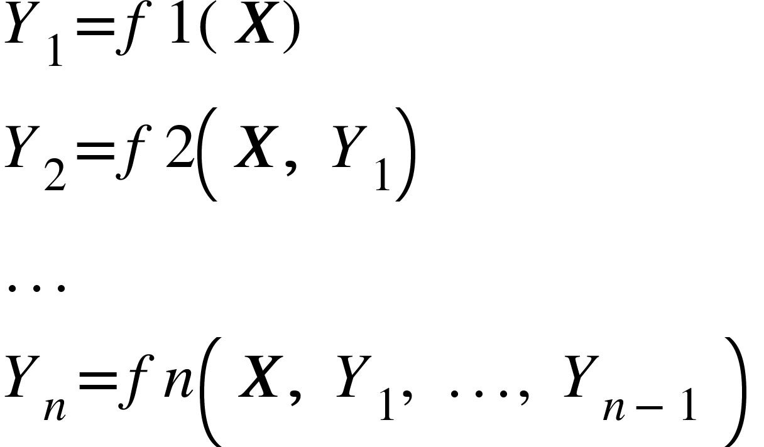
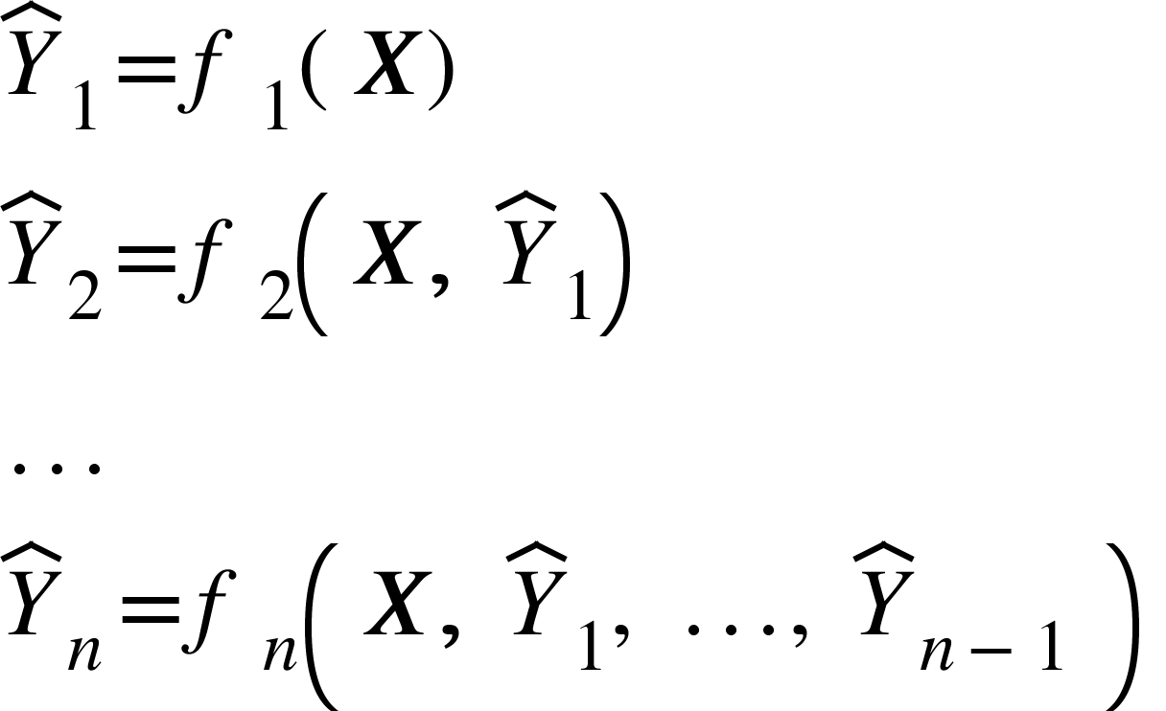
Synthesis - sequential regression
Y₁,…,Y_{n}: variables to be synthesized (agi, wages, etc.)
X: vector of predictors that will not be synthesized, aka “seeds” (can be null)
Estimate model for each variable, in sequence, using the true data. RHS is X and any already-modeled variables in the “visit sequence”:
Predict synthetic values for each variable. RHS is X and any already-synthesized values in the “visit sequence”:

Slide 9
Sequential synthesis approach (simplified)
Seed
Retained as-is in the synthesis
Calculated seed
Used for synthesis, later discarded
Synthesized variables
Generated from the conditional distribution
ID | MARS | AGI | Wages | Dividends
1 | Single | $70,000 | $65,000 | $1,000
2 | Married | $40,000 | $40,000 | $0
3 | Married | $200,000 | $130,000 | $40,000

Slide 10
Sequential synthesis approach (simplified)
Step 1
Copy the seed variables over
Optional: sample with replacement
ID | MARS | AGI | Wages | Dividends
1 | Single | $70,000 | $65,000 | $1,000
2 | Married | $40,000 | $40,000 | $0
3 | Married | $200,000 | $130,000 | $40,000
TRUE
ID | MARS | AGI | Wages | Dividends
1 | Single | $70,000
2 | Married | $40,000
3 | Married | $200,000
SYNTH

Slide 11
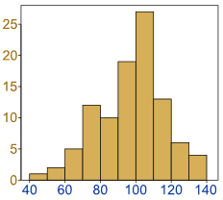
Sequential synthesis approach (simplified)
Step 2
Determine the conditional distribution of the first synthesized variable
ID | MARS | AGI | Wages | Dividends
1 | Single | $70,000 | $65,000 | $1,000
2 | Married | $40,000 | $40,000 | $0
3 | Married | $200,000 | $130,000 | $40,000
TRUE
Predicted distribution of wages conditional on MARS and AGI
ID | MARS | AGI | Wages | Dividends
1 | Single | $70,000
2 | Married | $40,000
3 | Married | $200,000
SYNTH
Wages

Slide 12
Sequential synthesis approach (simplified)
Step 3
Impute the first synthesized variable by selecting randomly from the predicted conditional distribution
ID | MARS | AGI | Wages | Dividends
1 | Single | $70,000 | $65,000 | $1,000
2 | Married | $40,000 | $40,000 | $0
3 | Married | $200,000 | $130,000 | $40,000
TRUE
Predicted distribution of wages conditional on MARS and AGI
ID | MARS | AGI | Wages | Dividends
1 | Single | $70,000 | $62,400
2 | Married | $40,000 | $40,000
3 | Married | $200,000 | $155,100
SYNTH
Wages

Slide 13
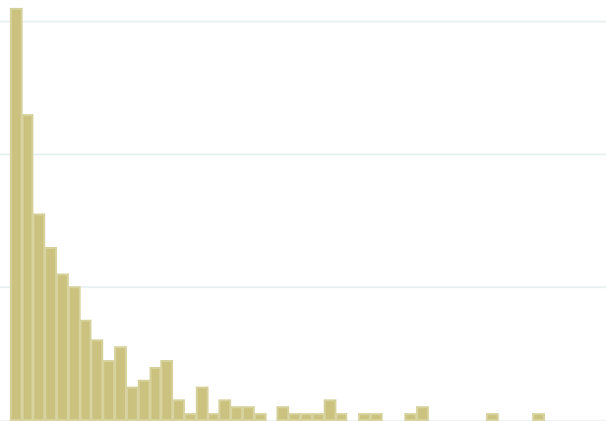
Sequential synthesis approach (simplified)
Step 4
Do steps 2-3 for subsequent variables, conditional also on previously synthesized values
ID | MARS | AGI | Wages | Dividends
1 | Single | $70,000 | $65,000 | $1,000
2 | Married | $40,000 | $40,000 | $0
3 | Married | $200,000 | $130,000 | $40,000
TRUE
Predicted distribution of dividends conditional on MARS, AGI, and wages
ID | MARS | AGI | Wages | Dividends
1 | Single | $70,000 | $62,400 | $0
2 | Married | $40,000 | $40,000 | $0
3 | Married | $200,000 | $155,100 | $43,900
SYNTH
Dividends

Slide 14
Sequential synthesis approach (simplified)
Step 5
Drop the calculated seeds
Recalculate after synthesizing all variables
ID | MARS | AGI | Wages | Dividends
1 | Single | $70,000 | $65,000 | $1,000
2 | Married | $40,000 | $40,000 | $0
3 | Married | $200,000 | $130,000 | $40,000
TRUE
ID | MARS | AGI | Wages | Dividends
1 | Single |  | $62,400 | $0
2 | Married |  | $40,000 | $0
3 | Married |  | $155,100 | $43,900
SYNTH

Slide 15
We use random forests to predict
Has been shown to perform well
Works well without a lot of tuning or labor
Has outperformed (slightly) our CART (classification and regression tree) efforts, especially in “sparse” areas of the data
We use the synthimpute Python package (written by Max Ghenis)
200 trees
14.5 hours on an Intel Core i7

Slide 16
Other approaches merit consideration
Our methods are used widely and work well with large data files
Econometric approaches, quantile regression, and related methods can be useful, often in two stages (e.g., TPC, Census):
Predict whether a variable is nonzero
Predict its value or distribution
Generative Adversarial Networks (GANs): deep learning methods in which a data-generating neural net communicates with a data-discriminating neural net; potential value re: differential privacy
Methods require choices about hyperparameters, functional form
These are on our radar screen and are longer-term possibilities

Slide 17
Disclosure review

Slide 18
Disclosure review
Synthesized records are not sampled data; but it is possible to produce by chance a synthesized record that exactly matches a PUF record.
More likely for a trivially simple record that occurs multiple times in the data set (e.g., all income and deduction variables are zero), than for a complex record that is unique.
Rule: No synthesized record may match any unique PUF record, exactly, on every synthesized variable.
We ensured that our data meet this rule, and had this certified.

Slide 19
Evaluating the synthetic file (before weighting)

Slide 20
Examining synthesis results (unweighted)
Individual variables
Many zero-values, highly skewed distributions
Examine percentage of values that are zero
Statistics that describe the variable and its distribution
Extent to which PUF and synthetic distributions overlap
Relationships among variables
Correlations
Plots of continuous vs. categorical (e.g., by marital status); not shown

Slide 21
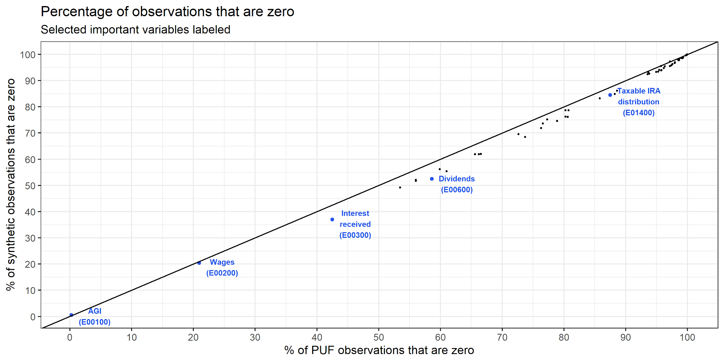
We (slightly) under-synthesize zero-values

Slide 22
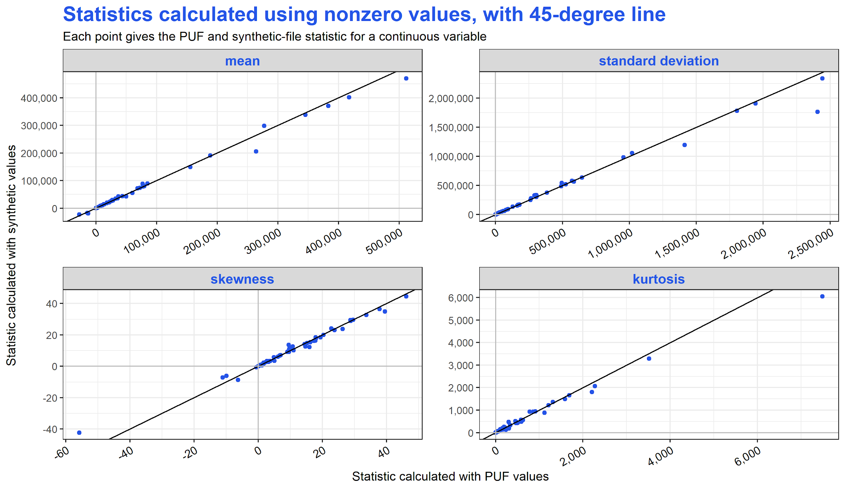
E00100 AGI (calculated)
E24518 28% Rate Gain or Loss
E24518 28% Rate Gain or Loss
P22250 Short-term gains less losses
Hump on left
Hump on right
P22250 Short-term gains less losses
Positive values: ~ heavier tails (more outliers) than normal distribution

Slide 23
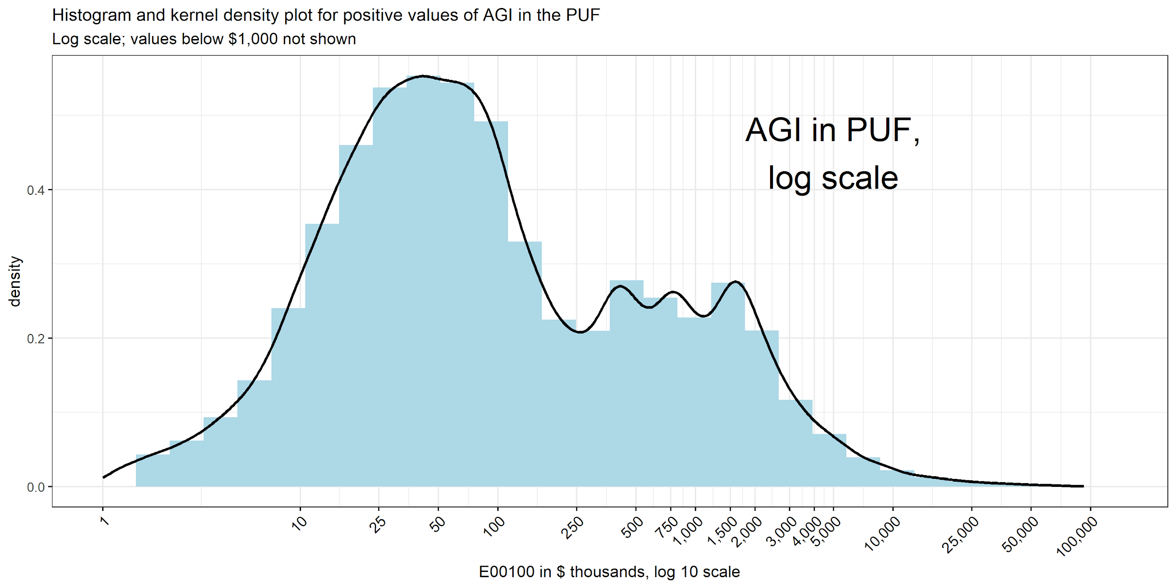
Kernel density plot is like a smoothed histogram. Useful for comparing distributions.
Note: Untransformed AGI has very steep hump near $60k & extremely long right tail.

Slide 24
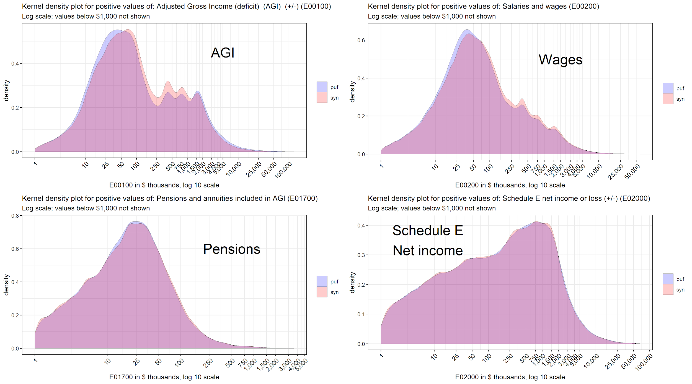
Kernel density plots, 4 large income variables (unweighted)

Slide 25
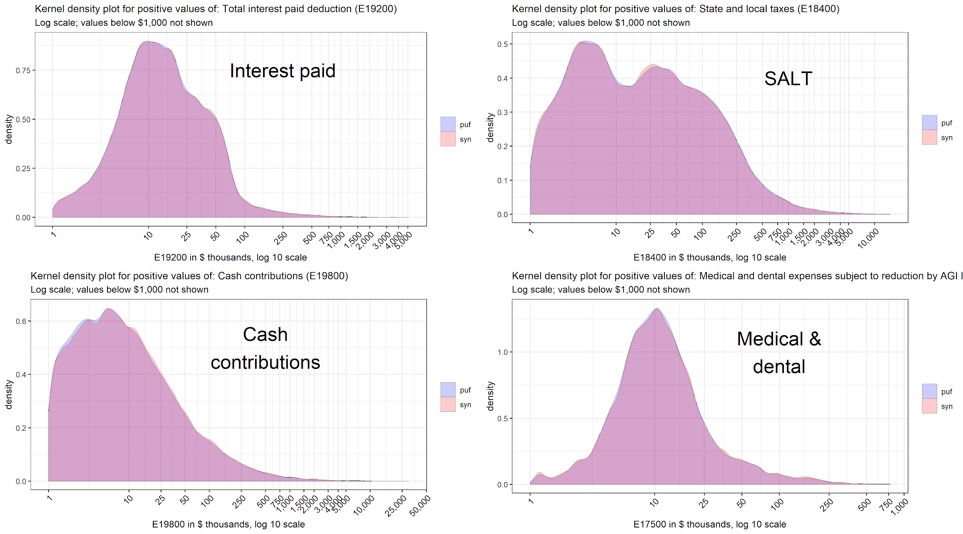
Kernel density plots, 4 large deduction variables (unweighted)

Slide 26
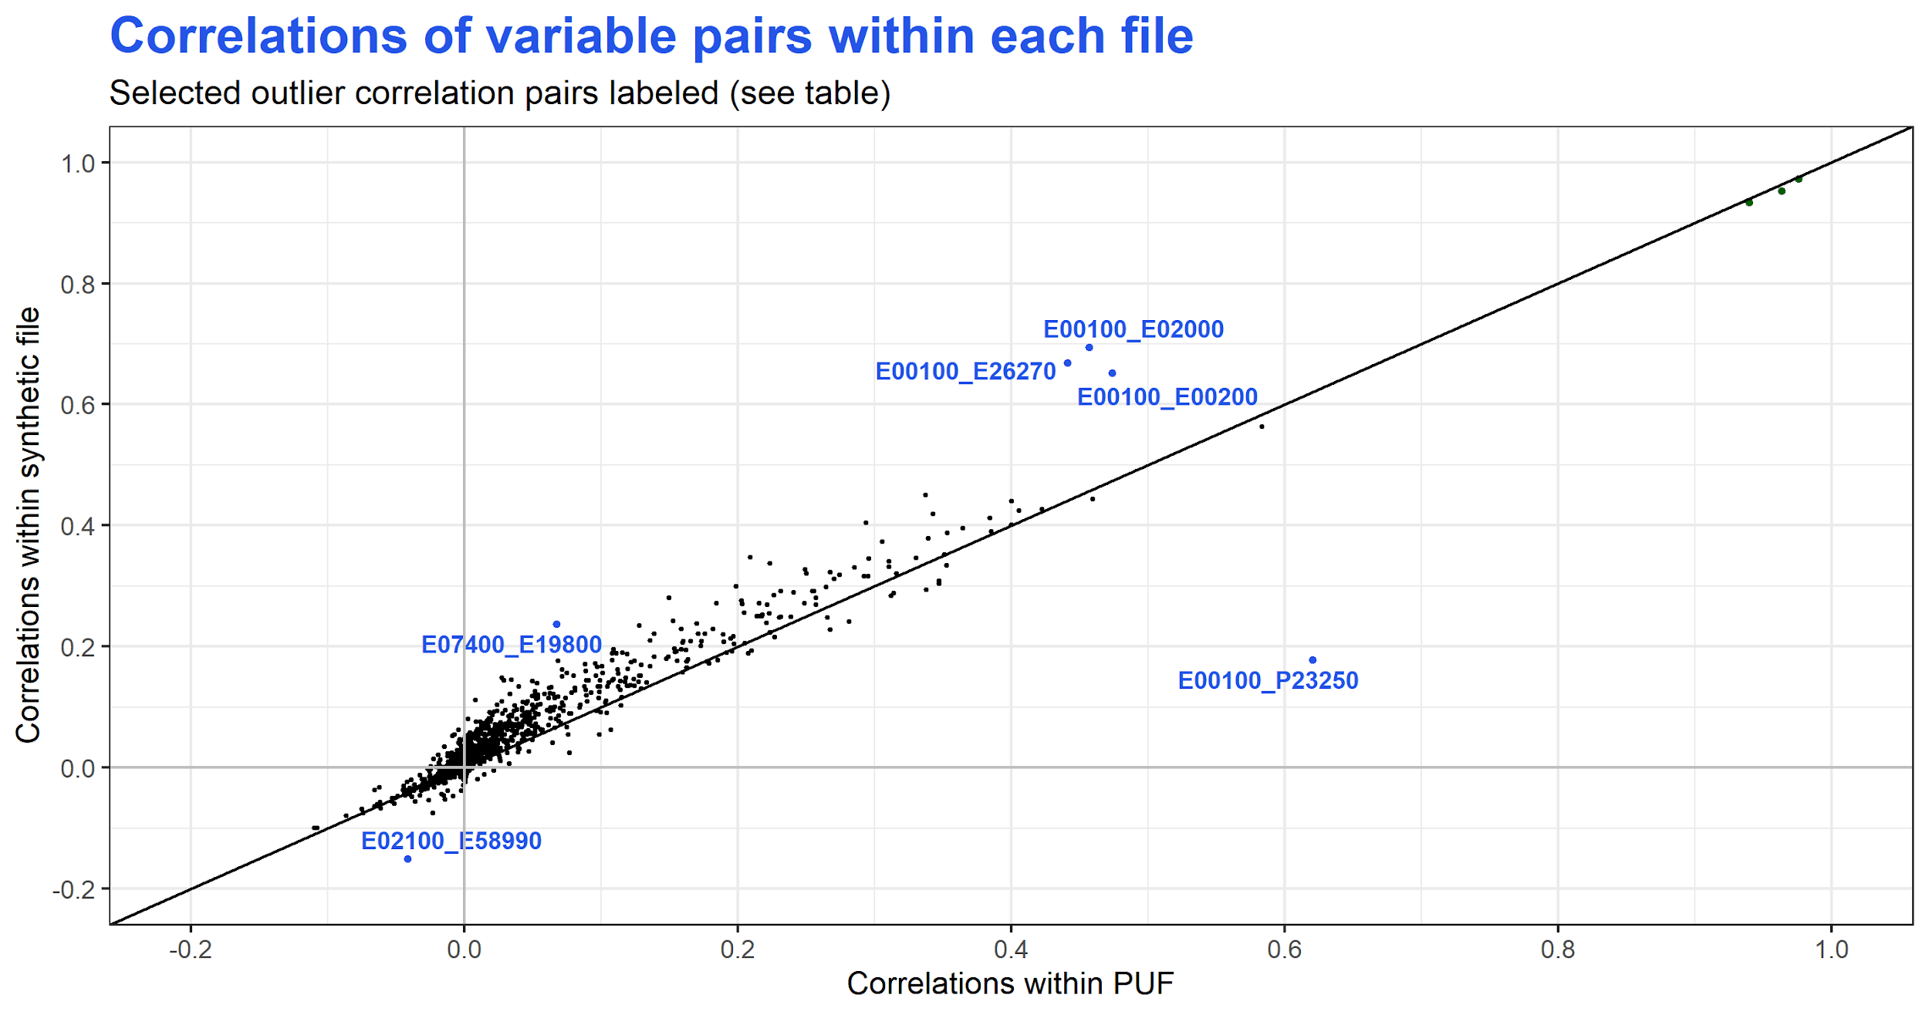

Slide 27
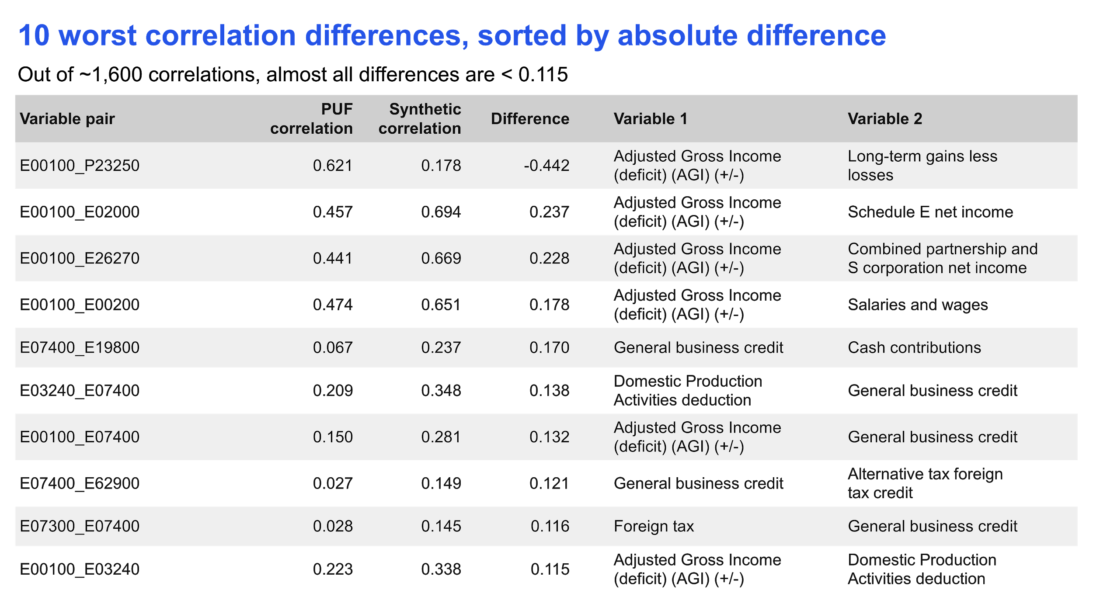

Slide 28
Constructing weights for the file

Slide 29
Overview of our weighting approach
Divide PUF into mutually exclusive subsets by AGI and marital status
Calculate weighted PUF values for all subsets
Divide synthetic file similarly into subsets
For each synthetic-file subset:
Choose weights that minimize the squared differences between weighted synthetic values and weighted PUF values (assign some targets higher priority than others)
124 subsets x ~128 targets each → ~16k targets
More details in the appendix.

Slide 30
Enhancing the file via TaxData

Slide 31
TaxData enhancement - major elements
Brings in selected information and relationships from the CPS ASEC, and prepares the file for Tax-Calculator:
Create tax units from the CPS file
Match tax units between the CPS and IRS-SOI
Split certain income items between prime and spouse
Add non-filers from the CPS to the matched file
Extrapolate data to future years

Slide 32
Comparing enhanced synthetic & PUF files
Currently, our best comparative synthetic file:
Has the CPS additions
With a few small workarounds, mostly relating to prime-spouse splits of Schedule E and F income. (Our next synthesis will address these issues.)
Extrapolated to the first tax year in Tax-Calculator: 2013.
For comparison we construct enhanced PUF with same CPS additions and workarounds, also extrapolated to 2013.
This allows tax-analysis comparison of:
apples that are slightly bruised (synthetic)
to
apples intentionally bruised in the same way (PUF)

Slide 33
Evaluating the weighted & enhanced synthetic file: Tax-Calculator analyses

Slide 34
Baseline calculations for 2017 law

Slide 35
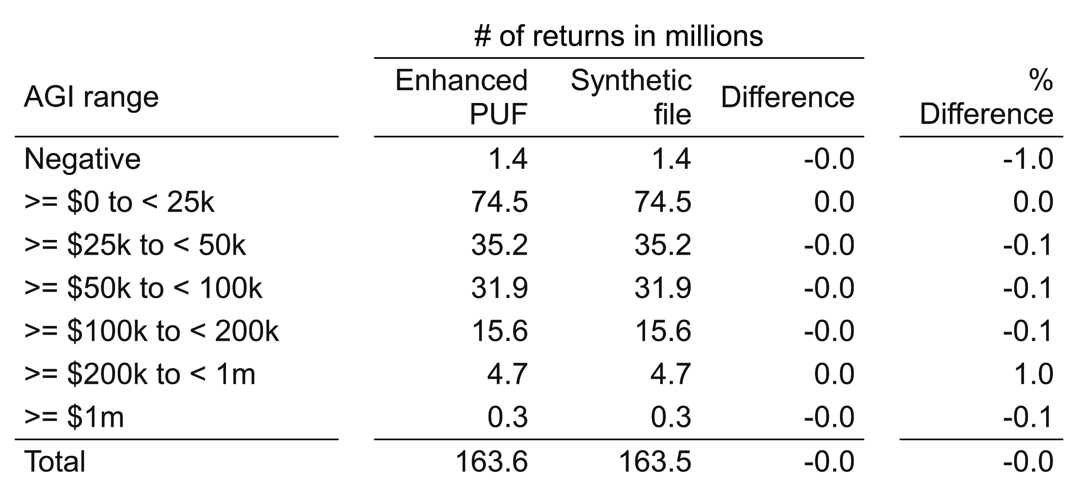
Number of returns (2017 tax law, 2013 income)
Enhanced synthetic file and enhanced PUF, comparability-adjusted

Slide 36
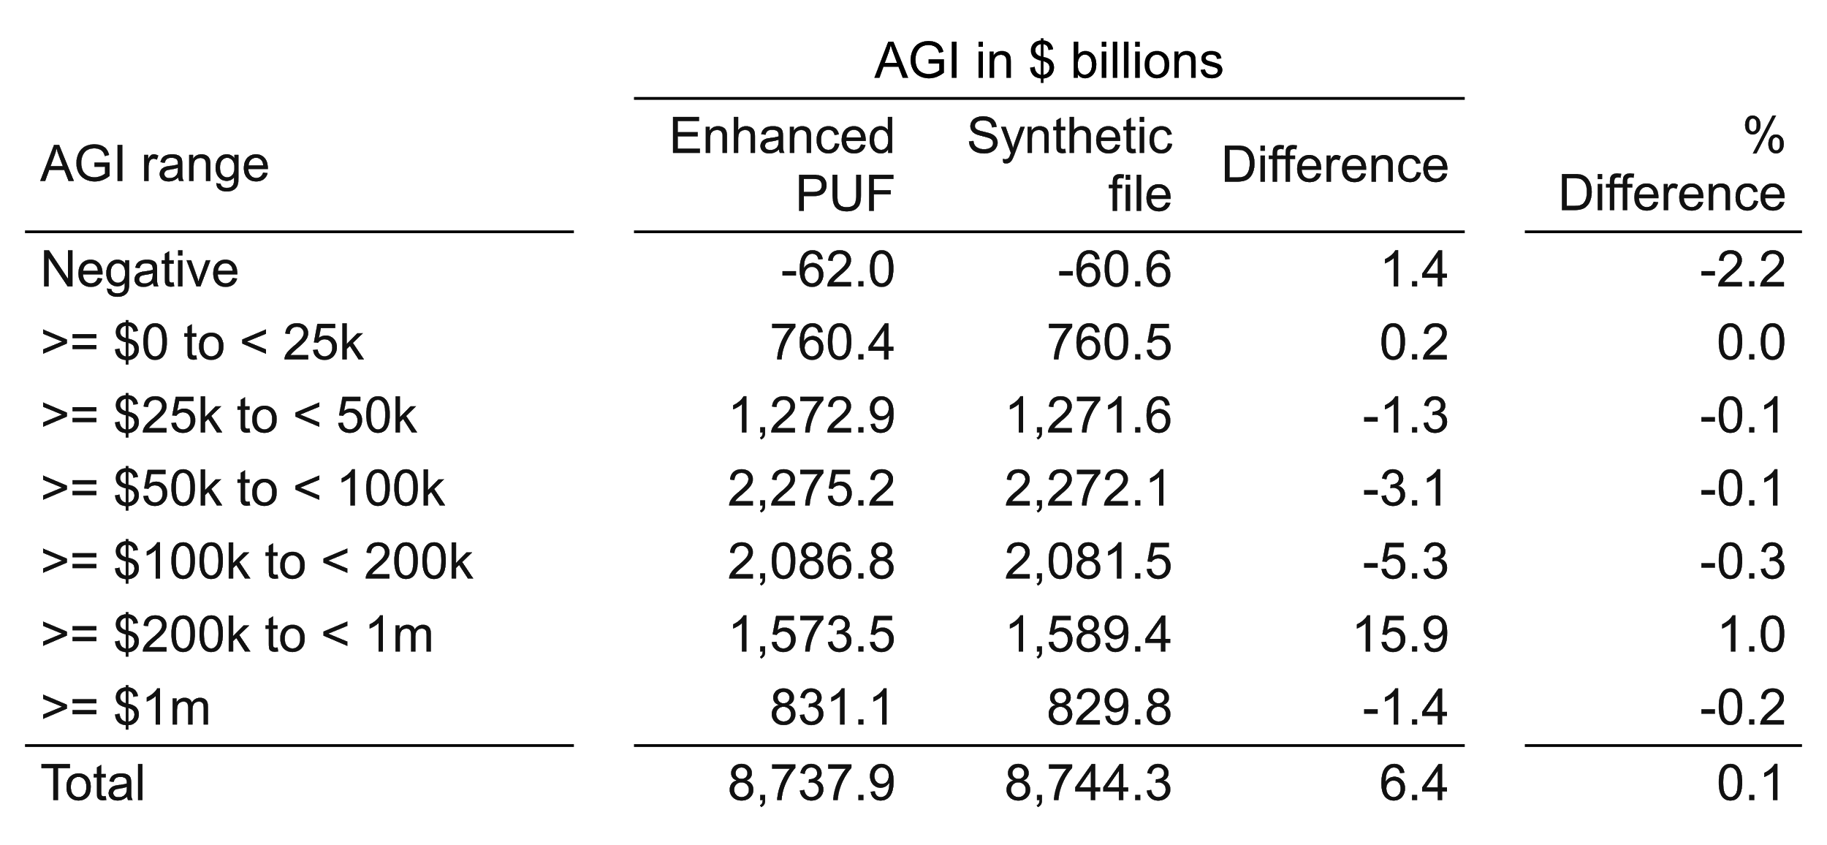
Adjusted gross income (2017 tax law, 2013 income)
Enhanced synthetic file and enhanced PUF, comparability-adjusted

Slide 37
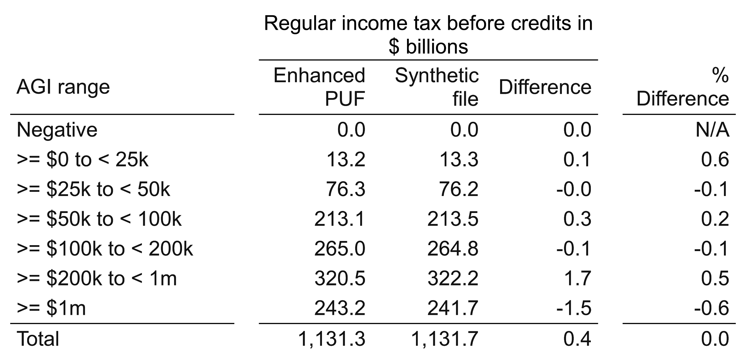
Regular tax before credits (2017 tax law, 2013 income)
Enhanced synthetic file and enhanced PUF, comparability-adjusted
This will come back to haunt us.

Slide 38
Now, simple
across-the board rate cuts
vs. 2017 law
Tables show:
$ billions change from 2017 law, PUF and synthetic
Synthetic estimated change vs. PUF estimated change, in $ billions and as % of PUF change
% change from 2017 law, PUF and synthetic
All tables have the same structure so we go through the first carefully.

Slide 39
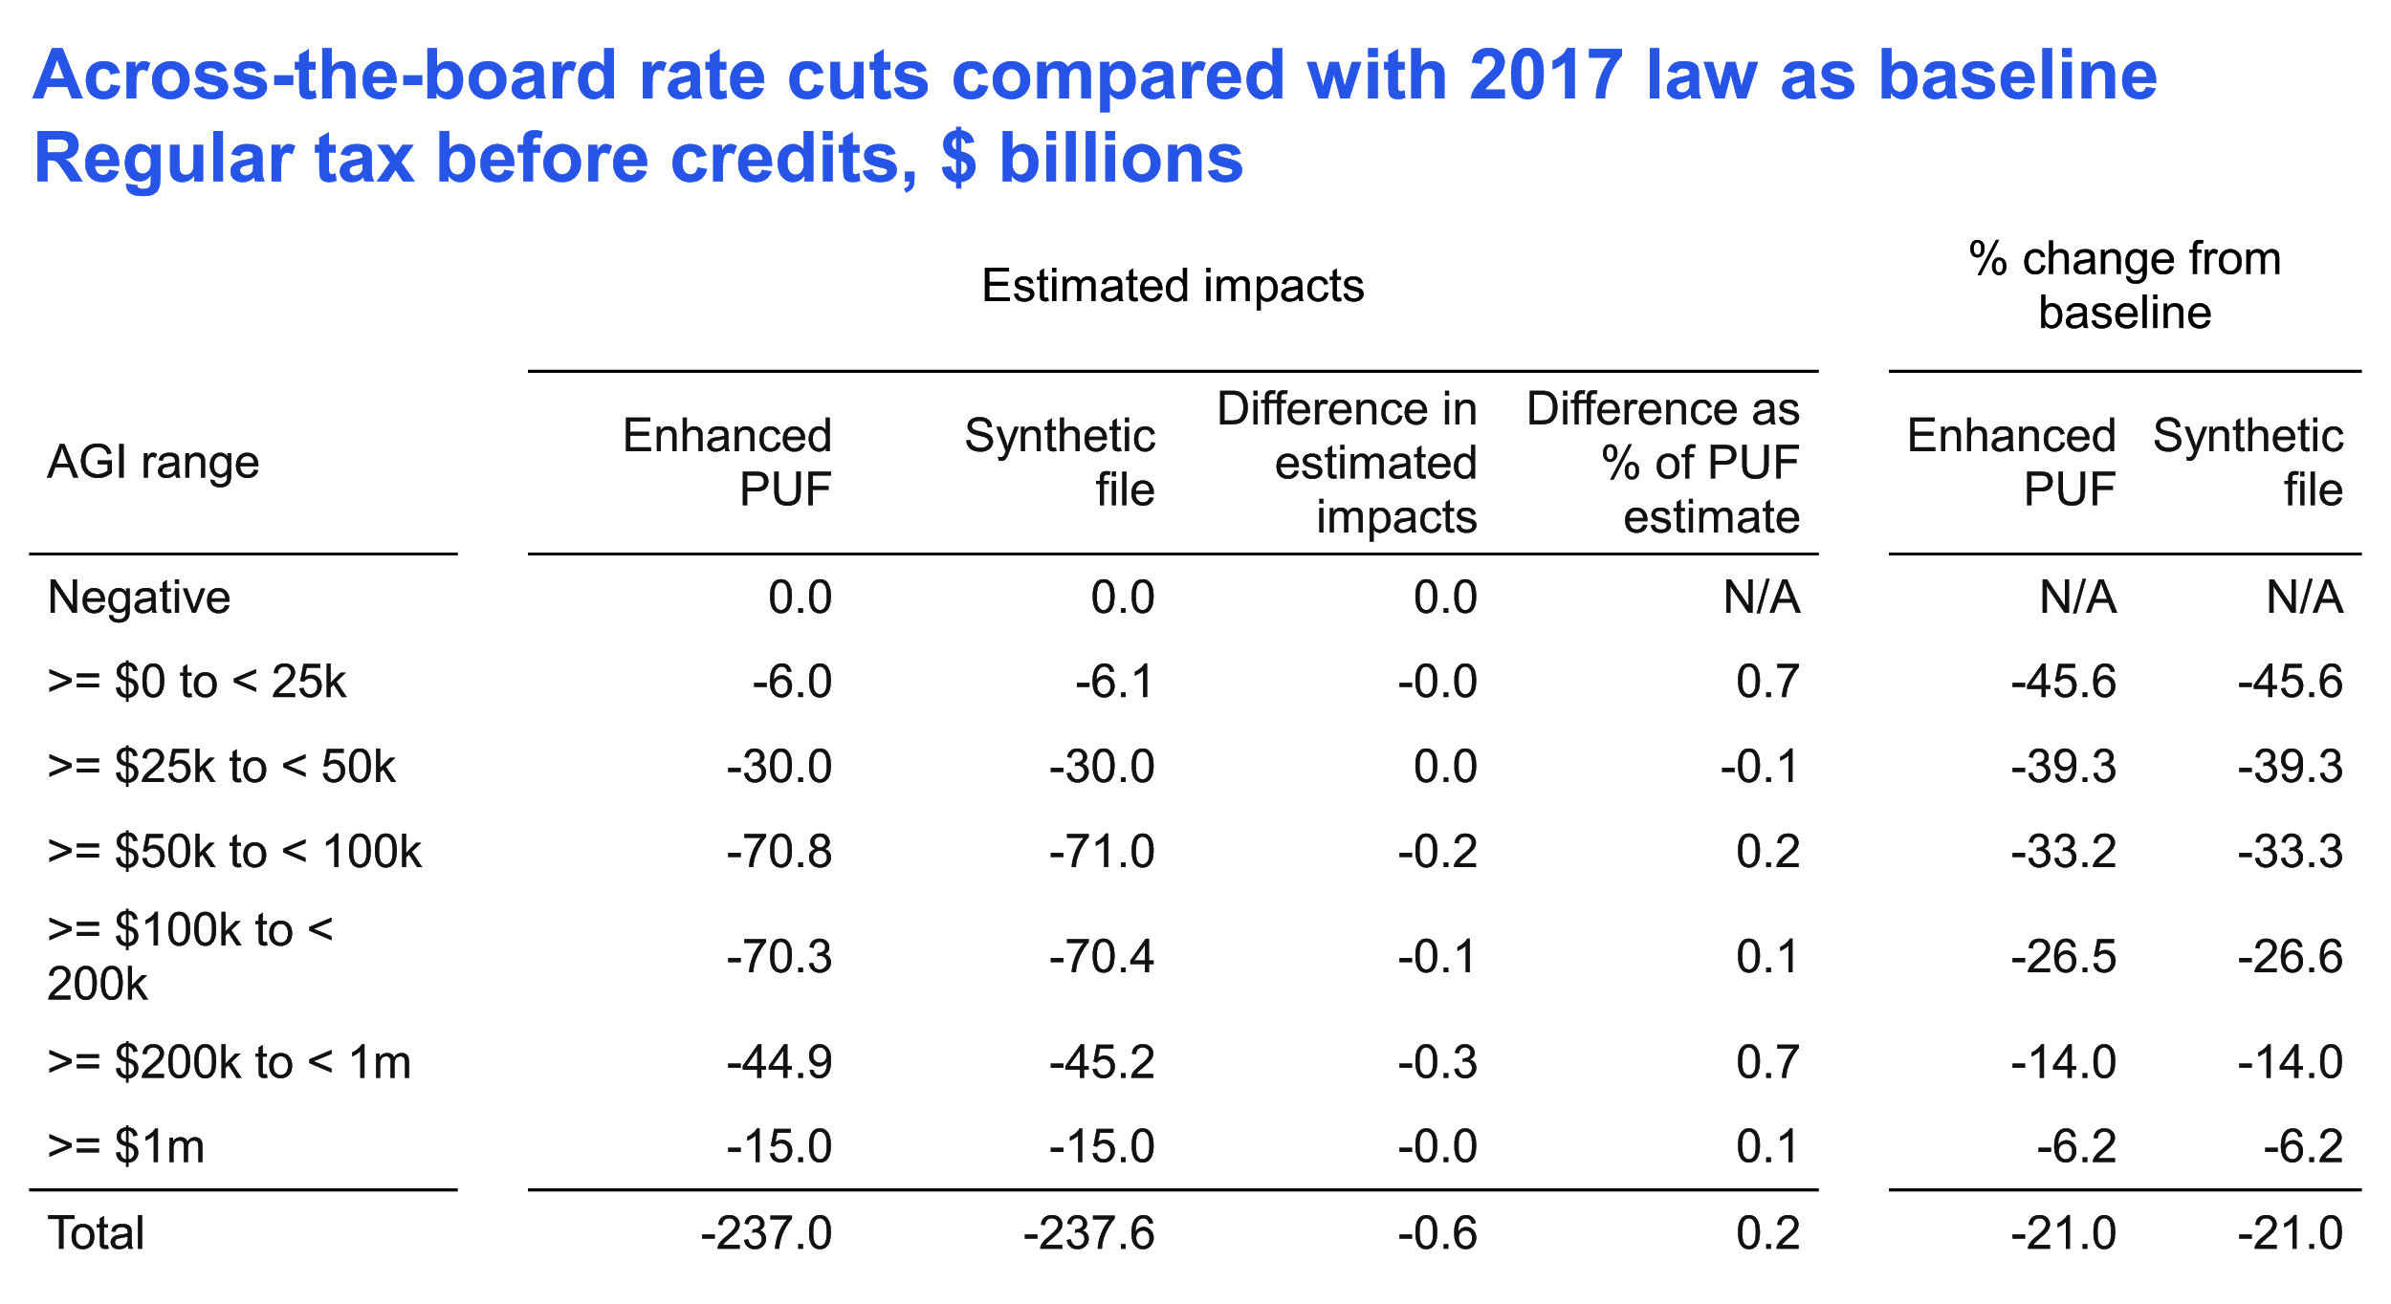

Slide 40
Next, a complex reform with winners and losers
vs. 2017 law
Eliminate all standard and itemized deductions
Decrease regular income tax rates
Increase capital gains rates and pass-through-income rates

Slide 41
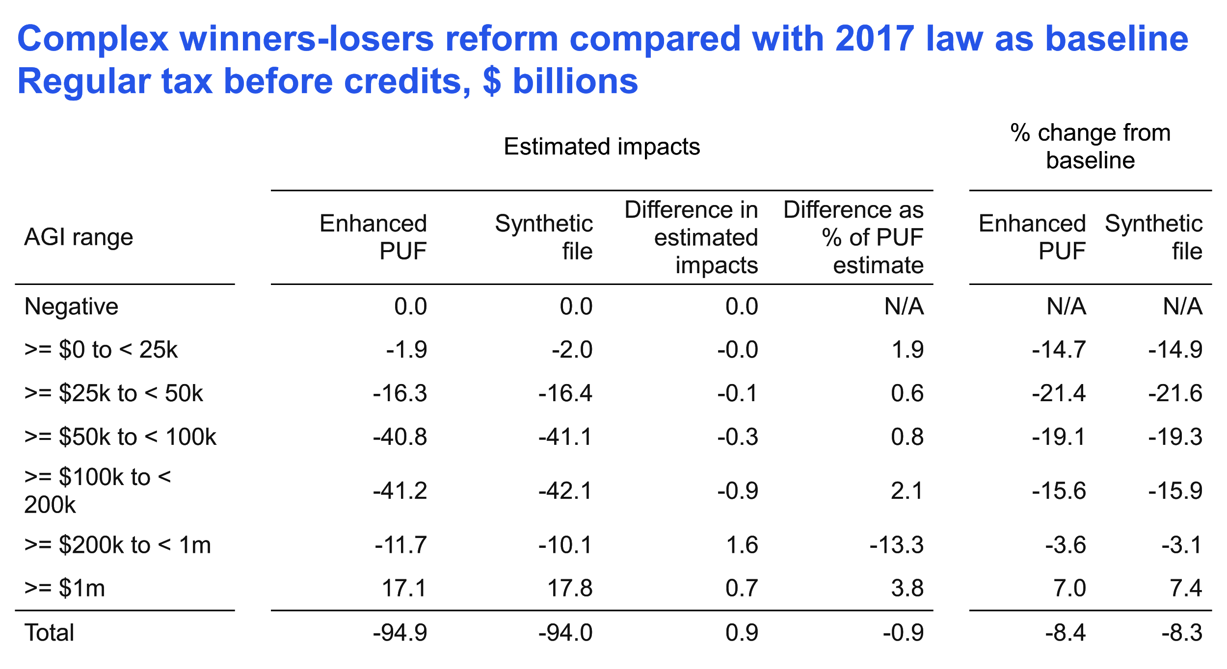

Slide 42
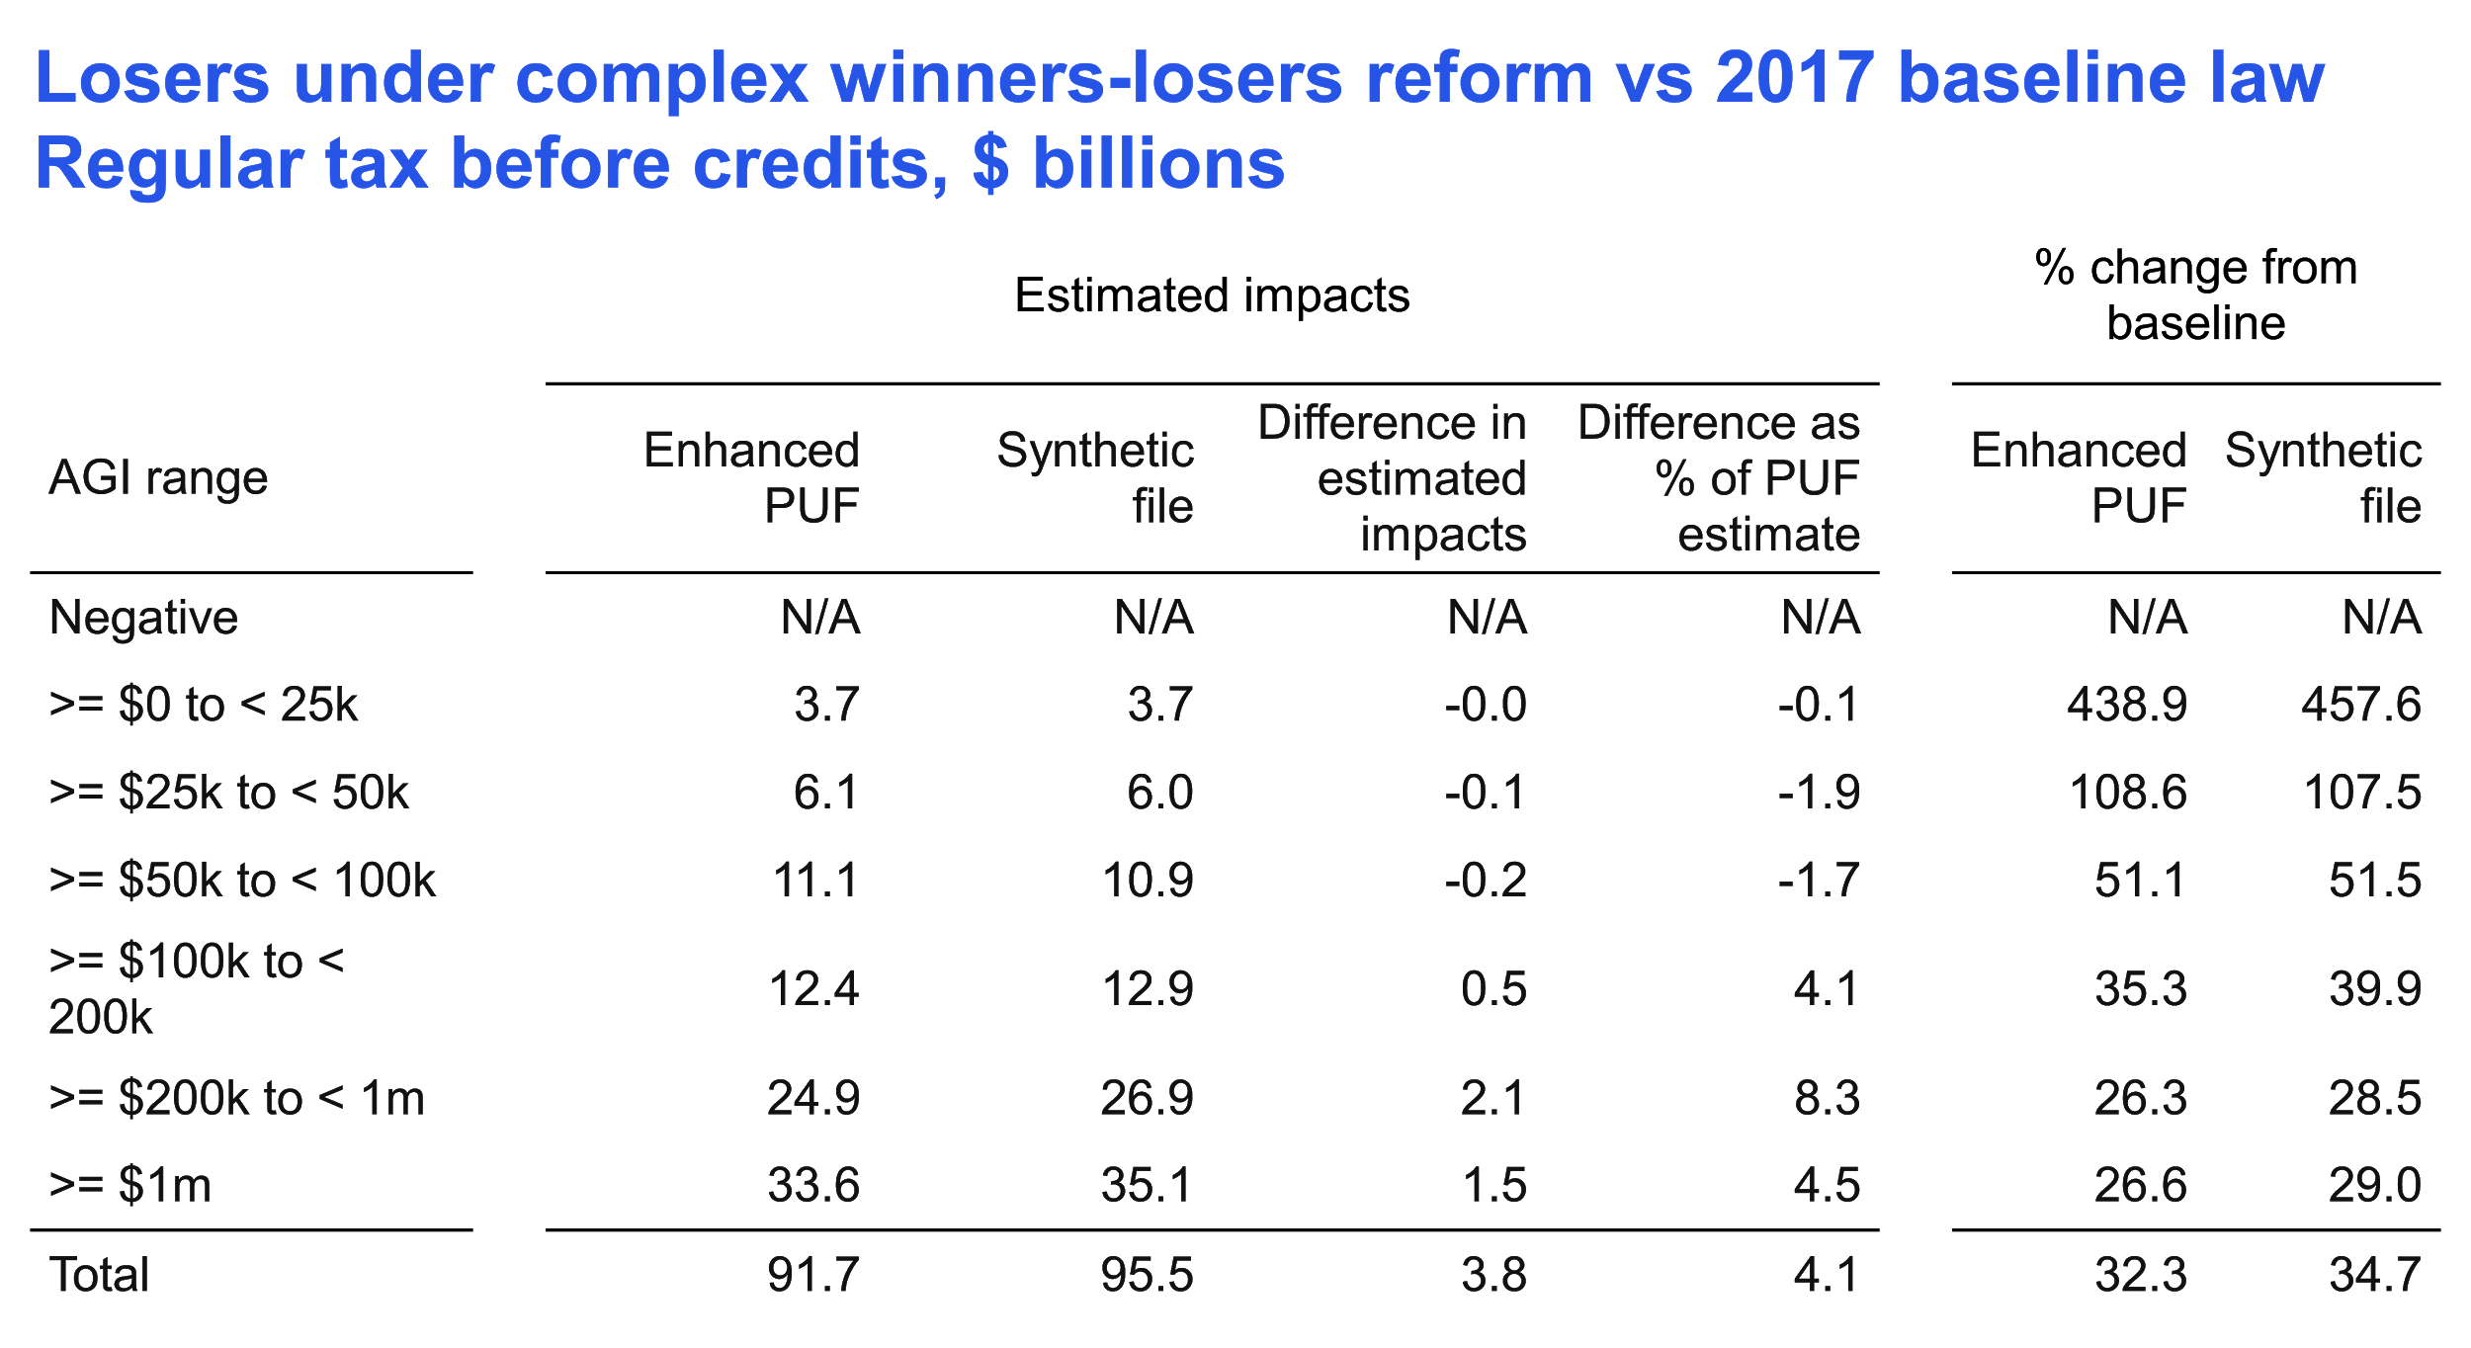

Slide 43
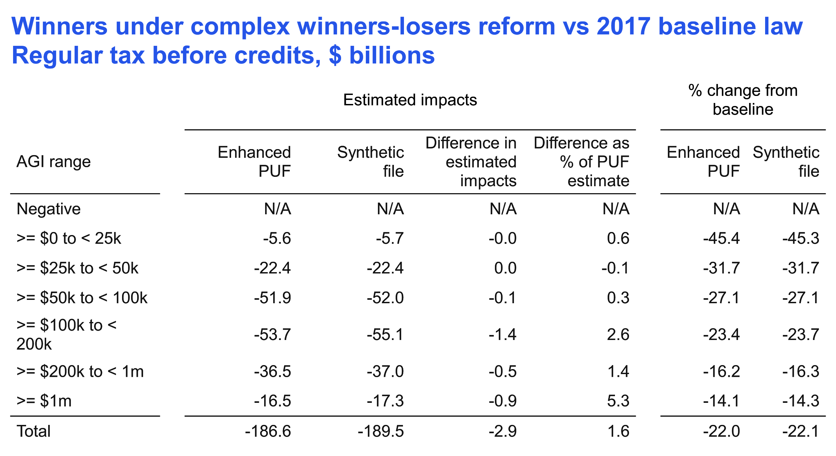

Slide 44
Drill down into single filers who are winners

Slide 45
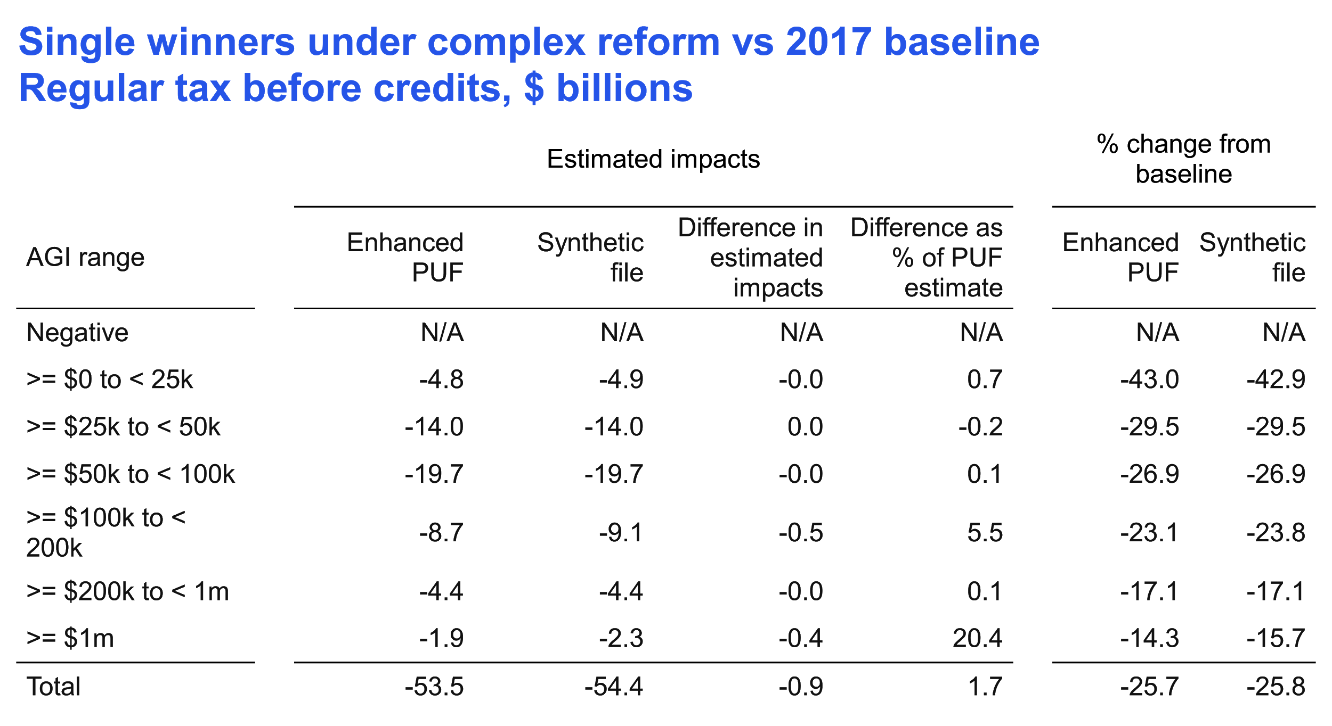
How much do these bother us (for a first effort)?

Slide 46
Dan Feenberg ran 108 tax reforms via NBER taxsim, on a synthetic file version and the PUF
He adjusted, in isolation, each tax or clawback rate by 1 % point, each $ threshold (e.g., brackets) by $1k, each income, adjustment, or deduction component by 10%, & abolished each credit.
Compared revenue impacts (% difference synthetic file vs. PUF):
55% of synthetic impacts were within 5% of PUF impact
Tax rate and bracket reforms did very well
Changes to large income items (e.g., wages) generally did well
Reforms affecting items that few taxpayers have did very poorly (e.g., deductions for domestic production activities, self-employment health insurance)

Slide 47
Lessons and next steps

Slide 48
Lessons (1)
Unweighted files: Univariate statistics, distributions, and correlations generally look quite good. Problems with gains and losses. Diagnostics will help us determine fixes.
Weighted file, baseline tax: Synthetic file is close to enhanced PUF on many aggregates. Problems in highest income ranges and AMT.
Simple rate cut: Easy: we just have to get weighted distribution of AGI and taxable income right, not income components.
Complex reform: Did well in aggregate, but:
Top 2 income ranges gave trouble. Likely related to AGI mis-distribution. Could be a weighting or a synthesis problem.
Drilling deeply into winners/losers and marital status reveals some large % errors, albeit small relative to overall tax liability.

Slide 49
Lessons (2)
Dan’s multitude of reforms: Items affecting small groups of taxpayers are problematic.
Status: Not ready for all-purpose real-world decisions (aspirational). Useful for selected reforms. Useful for professors and students for policy analysis.
These analyses teach us how to:
Improve our synthesis
Improve our weighting
Provide guidance about safe and unsafe uses
Improved files will open up more potential uses.

Slide 50
Near-term next steps
Run current synthetic file fully through TaxData so that it can be used by others as experimental file in Tax-Calculator and Tax-Brain.
We will make this alpha file available as soon as practical.
We welcome your participation - and participation by any interested people - in the development and use of this alpha file.
Seek support for improvements in all aspects of project.
Please let us know what you think!

Slide 51
Appendix:
Additional details
Bibliography

Slide 52
Examples
Census Bureau’s Synthetic Longitudinal Business Database: “Unless validated, there is no guarantee results from the SynLBD reflect results from the underlying confidential data”
Scottish Longitudinal Study synthetic data: “Bespoke synthetic extracts are produced using the R package synthpop...Variables are synthesised one by one using sequential regression modelling...The SLS synthetic dataset will look and behave relatively similarly to the real data. However, there is no guarantee of the validity of the results...Any analysis for publication must be run on the real dataset within the SLS Safe Setting”
TPC goals: Fully synthetic tax files for testing programs; full programs to be run on IRS computers in safe environment.

Slide 53
This is different from and complements the Tax Policy Center’s project on synthetic data
TPC project is far more extensive: substantial edits to underlying IRS and SSA data and construction of a far larger fully synthetic PUF directly from source tax data; many more schedules and items than current PUF.
TPC synthetic PUF likely to be richer and more faithful to tax data.
Our project is limited to creating synthetic data directly from current PUF, and data will be available much sooner.
Depending on how the projects evolve a TPC fully synthetic PUF, when ready, could be an improved replacement for synthetic data we create.

Slide 54
Specific data and methods choices
Data: 2011 raw PUF. Delete the 4 aggregate records. Select and synthesize 65 variables (55 continuous, 10 categorical) needed for Tax-Calculator.
Enforce relationships:
Separately synthesize pensions and annuities included in AGI (e01700) and those not included; construct their sum (e01500).
Use a variant on this approach for qualified and ordinary dividends.
Seeds:
Use marital status and record weight as is
Use 9 additional variables on RHS for all estimations/predictions but drop from output: AGI (e00100), exemption amount (e04600), deduction amount (p04470), taxable income (e04800), AMT income (e62100), income tax before credits (e05800), income tax after credits (e08800), earned income for the EIC (e59560), and non-passive income (e26190). Much later, calculate from components.
Visit sequence: largely is descending size by sum of weighted values in PUF
Output: 5x as many synthetic records as PUF records -- 750-800k records

Slide 55
Weighting approaches considered
Reweighting:
When we created the data, we synthesized (modeled and predicted) record weights based on relationships to other variables
Reweighting starts with these synthesized weights and adjusts:
So that the weighted file hits or comes close to targets based on PUF aggregates,
While penalizing adjustments - the less adjusted, the better
“Weighting from scratch”:
Throw away (ignore) the synthesized weights, and instead...
Choose new weights from whole cloth in a way that minimizes difference between PUF-based targets and weighted file values

Slide 56
Currently we use “weighting from scratch”
Divide PUF into subsets of ~1-2k records based on marital status and AGI -- 124 subsets.
For each subset, for each of ~55 variables, calculate 4 measures: weighted numbers of positive values & negative values, weighted sums of positive & negative values -- i.e., ~220 potential targets.
Remove certain redundant targets. This gives ~128 targets per subset.
Divide synthetic file into subsets using same cutpoints (~5-10k records each).
For each subset, choose weights for each record that minimize a priority-weighted sum of squared differences between actual PUF targets and computed synthetic sums (using the chosen weights).
Highest priority in the sum of squared differences is given to AGI and a few other critical variables. This is based on judgment.

Slide 57
Simplified example for one file subset
Let’s say PUF file subset # 17 (out of 124 subsets) has 1k married-joint PUF records with AGI in the $10-20k range and:
Total AGI of $580 million
Total negative capital gains of -$50 million
...and 126 other targets
We want AGI target to be 20x as important as capital gains target
Corresponding synthetic subset has 5k married-joint records with $10-20k AGI. We choose 5k weights ws[i] that minimize the penalty function:
20 * {sum(ws[i] * agi[i]) - 580}^2
1 * {sum(ws[i] * (capgains[i] if negative)) - -50}^2
priority-weighted squared differences from ~126 additional targets
Note: We also do some scaling, not shown here.

Slide 58
Solving the weighting problem
We have:
124 file subsets
~5-10k synthetic records per subset, choose weight for each record
~128 targets per subset
Thus we have ~16k targets (124 x 128) for the entire synthetic file
File subsets are mutually exclusive and can be solved in parallel
Penalty function is nonlinear. No constraints (they are built into objective function). Bounds on the weights (e.g., >=1).
Currently we solve with MMA (method of moving asymptotes)
Solves in about an hour, in parallel (6 cores), with 500 iteration limit
Generally suboptimal but very good solutions; could run longer

Slide 59
Additional baseline calculations for 2017 law

Slide 60
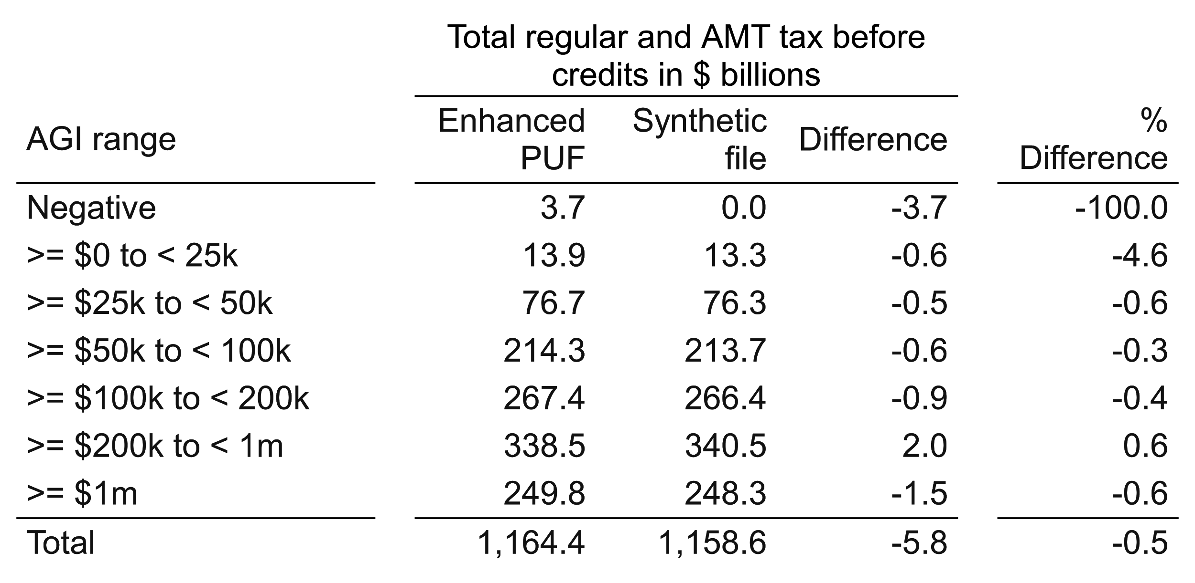
Total regular tax + AMT (2017 tax law, 2013 income)
Enhanced synthetic file and enhanced PUF, comparability-adjusted

Slide 61
Selected Relevant Reports and Papers (1)
Benedetto, Gary, Jordan C Stanley, and Evan Totty. “The Creation and Use of the SIPP Synthetic Beta v7.0.” U.S. Bureau of the Census, November 2018. https://www.census.gov/content/dam/Census/programs-surveys/sipp/methodology/SSBdescribe_nontechnicalv7.pdf.
Benedetto, Gary, and Martha Stinson. “Disclosure Review Board Memo: Second Request for Release of SIPP Synthetic Beta Version 6.0.” Survey Improvement Research Branch, Social, Economic, and Housing Statistics Division (SEHSD), U.S. Bureau of the Census, January 15, 2015.
Bryant, Victoria L. “General Description Booklet for the 2011 Public Use Tax File.” Individual Statistics Branch, Statistics of Income Division, Internal Revenue Service, August 2016.
Burman, Leonard E, Alex Engler, Surachai Khitatrakun, and Sarah Armstrong. “A Synthetic Income Tax Return Data File: Tentative Work Plan and Discussion Draft,” June 30, 2017, 42. https://www.taxpolicycenter.org/sites/default/files/publication/142421/2001396-a-synthetic-income-tax-return-data-file-tentative-work-plan_and_discussion_draft.pdf.
Burman, Leonard, Surachai Khitatrakun, and Philip Stallworth. “Proposed Methodology for Creating a Fully Synthetic Dataset and Privacy Implications.” For presentation at Syracuse University Maxwell School Center for Policy Research, October 2018. https://www.maxwell.syr.edu/uploadedFiles/cpr/events/cpr_seminar_series/Synthesis%20methodology%20and%20privacy%20Center%20for%20Policy%20Research.pdf.
Caiola, Gregory, and Jerome P Reiter. “Random Forests for Generating Partially Synthetic, Categorical Data.” Transactions on Data Privacy 3 (2010): 16.

Slide 62
Selected Relevant Reports and Papers (2)
Drechsler, Jörg. Synthetic Datasets for Statistical Disclosure Control: Theory and Implementation. Springer Science & Business Media, 2011.
Drechsler, Jörg, and Jerome P. Reiter. “An Empirical Evaluation of Easily Implemented, Nonparametric Methods for Generating Synthetic Datasets.” Computational Statistics & Data Analysis 55, no. 12 (December 2011): 3232–43. https://doi.org/10.1016/j.csda.2011.06.006.
Reiter, Jerome P. “Satisfying Disclosure Restrictions With Synthetic Data Sets.” Journal of Official Statistics, 2002, 19.
Reiter, J P. “Using CART to Generate Partially Synthetic Public Use Microdata.” Journal of Ofﬁcial Statistics 21, no. 3 (2005): 22.
Snoke, Joshua, Gillian M. Raab, Beata Nowok, Chris Dibben, and Aleksandra Slavkovic. “General and Specific Utility Measures for Synthetic Data.” Journal of the Royal Statistical Society: Series A (Statistics in Society) 181, no. 3 (June 2018): 663–88. https://doi.org/10.1111/rssa.12358.
Winglee, Marianne, Richard Valliant, Jay Clark, Yunhee Lim, Michael Weber, and Michael Strudler. “Assessing Disclosure Protection for a SOI Public Use File.” Presented at the 2002 American Statistical Association: Internal Revenue Service, 2002. https://www.irs.gov/pub/irs-soi/weber.pdf.
Woo, Mi-Ja, Jerome P. Reiter, Anna Oganian, and Alan F. Karr. “Global Measures of Data Utility for Microdata Masked for Disclosure Limitation.” Journal of Privacy and Confidentiality 1, no. 1 (April 1, 2009). https://doi.org/10.29012/jpc.v1i1.568.
Zayatz, Laura. “Disclosure Avoidance Practices and Research at the U.S. Census Bureau: An Update.” Research Report Series, August 31, 2005.

